Slide 1
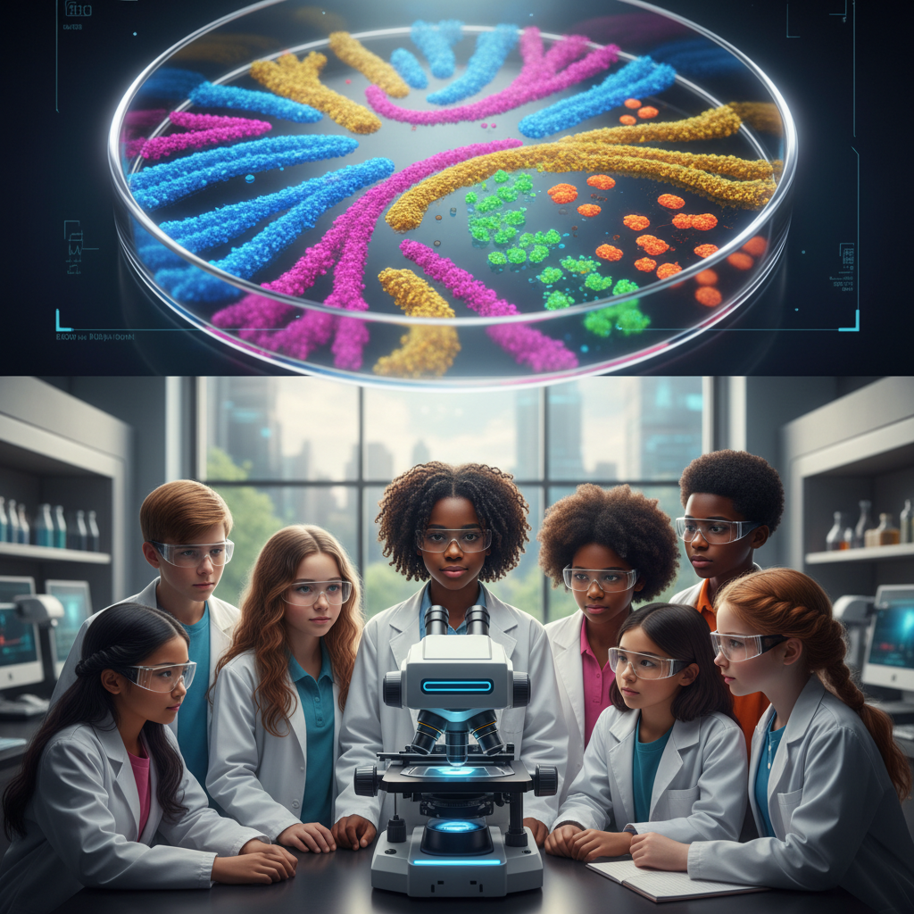
ModelIt!
Student Lesson
Superbugs: Evolution You Can See
Why Antibiotics Are Losing the War Against Bacteria
NGSS: MS-LS4-4, MS-LS4-6
8th Grade
1/9

Slide 2
What You Will Learn Today
Learning Goals
* Explain how random genetic mutations create variation in bacterial populations
* Model how antibiotic use selects for resistant bacteria over generations
* Predict how misuse of antibiotics accelerates resistance evolution
* Evaluate real-world strategies for slowing antibiotic resistance
Key Vocabulary
Antibiotic Resistance
The ability of bacteria to survive exposure to antibiotics that once killed them
Natural Selection
The process where organisms with favorable traits survive and reproduce more
Mutation
A random change in DNA that can create new traits
Selective Pressure
An environmental factor that favors certain traits over others
2/9

Slide 3
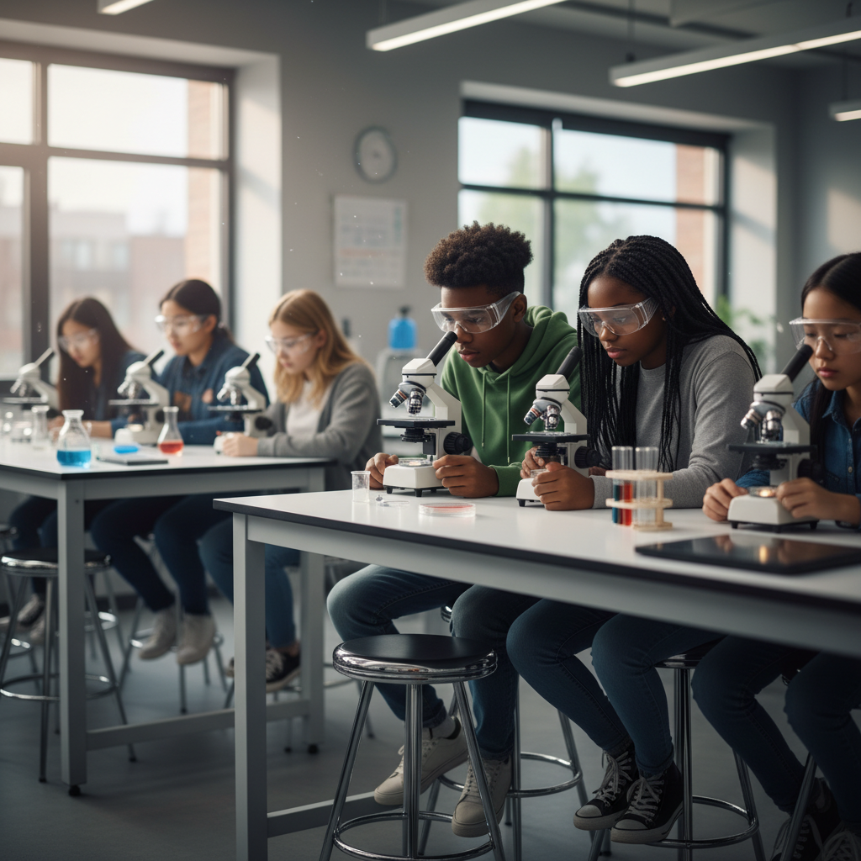
The Big Question
Why are bacteria becoming impossible to kill?
Why Antibiotics Are Losing the War Against Bacteria. Today we'll build a MODEL to discover the answer!
3/9

Slide 4

Today We Will Build a Model!
A model helps us understand complex systems!
1. LOCATE
Identify the COMPONENTS (parts) of the system
2. ESTABLISH
Connect them with RELATIONSHIPS (+ or -)
3. VISUALIZE
Build your model in ModelIt!
4. EVALUATE
Run SIMULATIONS to test scenarios
5. REVISE
Improve your model based on evidence
4/9

Slide 5

Activity 1: Sort the Components
Sort these components into EXTERNAL (inputs from outside) and INTERNAL (inside the system):
Your Components:
* Antibiotic Use
* Mutation Rate
* Resistant Bacteria
* Treatment Effectiveness
Think: Which components can we control? Which happen on their own?
5/9

Slide 6
Activity 2: Connect with Arrows
Draw arrows to show HOW components affect each other:
(+) POSITIVE Relationship
When one goes UP, the other goes UP too
(-) NEGATIVE Relationship
When one goes UP, the other goes DOWN
Think About It:
When antibiotic use increases, what happens to the percentage of resistant bacteria in the population over time?
6/9

Slide 7
Activity 3: Run the Simulation!
Test these scenarios in ModelIt!
Normal Treatment
Set Antibiotic Use and Mutation Rate to moderate levels
Overuse Crisis
Lock Antibiotic Use to 100% and observe what happens over 20 generations
Smart Use
Set Antibiotic Use to 30% and compare to overuse results
Watch the activity graphs change!
[ModelIt Platform Screenshot - Simulation Results Graph]
7/9

Slide 8
What Did We Discover?
Our Model Showed Us:
* Random mutations create resistant bacteria BEFORE antibiotics are even used
* Antibiotics don't cause resistance — they SELECT for bacteria that already have it
* Overuse accelerates the evolution of resistant populations dramatically
* Reducing antibiotic use slows resistance evolution but doesn't reverse it instantly
Answer: Antibiotics kill susceptible bacteria but leave resistant ones alive to reproduce. Over many generations, the population evolves to be mostly resistant — creating superbugs!
8/9

Slide 9

STEM Challenge: Design a Hospital Antibiotic Policy
YOUR ENGINEERING MISSION
Design an evidence-based antibiotic use policy for a hospital that minimizes resistance evolution while still effectively treating infections.
The Challenge:
A hospital is seeing increasing antibiotic-resistant infections in patients. The medical director needs your team to propose a new policy using evidence from your model.
Think Like an Engineer:
* What antibiotic use level minimizes resistance while still treating infections?
* How should doctors decide when to prescribe antibiotics vs. when to wait?
* What role does completing the full course of antibiotics play?
REAL CAREER CONNECTION: Epidemiologists and Microbiologists track antibiotic resistance patterns worldwide and develop strategies to combat superbugs. They earn $80,000-$130,000/year. The skills you're using TODAY are the same ones they use on the job!
9/9

